Slide 1
PROJECT ON POWER BI
PROJECT ON POWER BI

Slide 2
Problem Statement
We have the sales data of a restaurant of the last 15 days. It consists of details on the time of customer visit, type of orders, the amount spent against the orders by the customers, etc.
The restaurant provides a variety of menus.
However, the management wants to take action on cost-cutting and improving the profit.
Analyse the data and help them by providing actionable insights with the visual representation of data analysis to justify your suggestions.

Slide 3
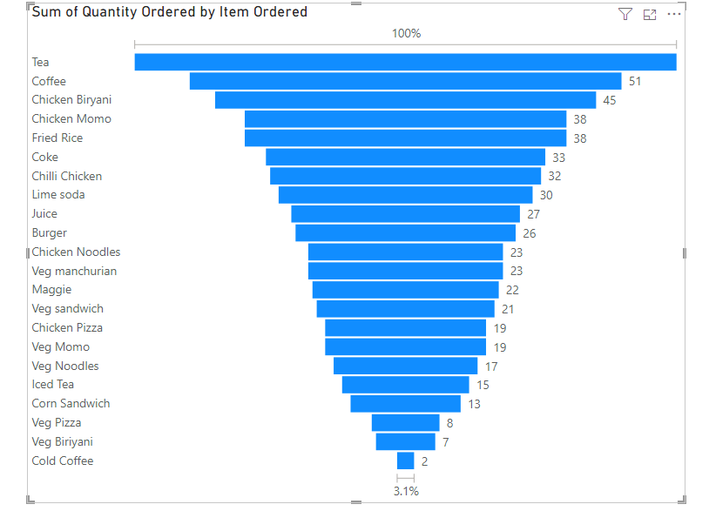
One month analyse this data
Tea is the most selling item in this restaurant
Cold coffee is the least selling item in
this restaurant

Slide 4
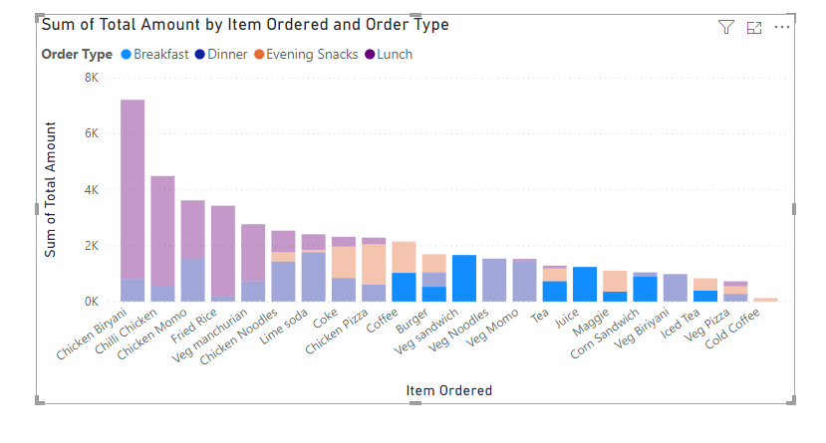
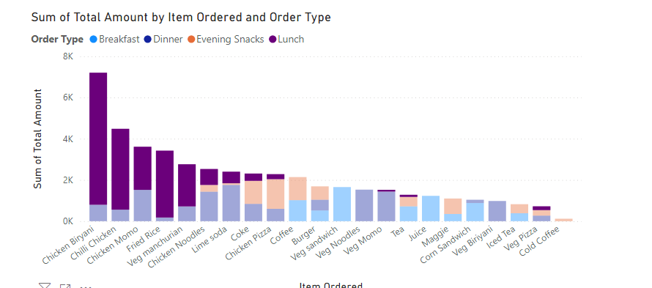
Breakfast time most of the item sells are tea, coffee ,veg sandwich , veg noodles, juice, Maggie
Lunch time top selling item is Chicken Biryani , Chili Chicken, Chicken Momo, Fried Rice ,
Veg Manchurian

Slide 5
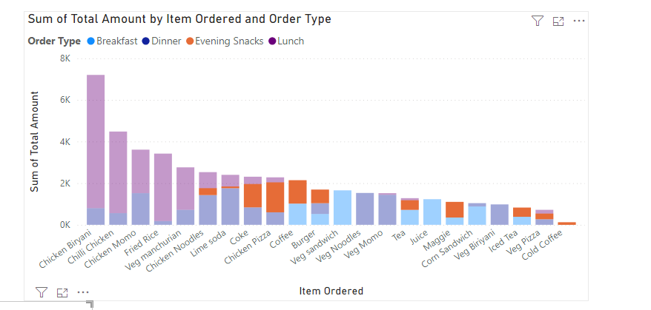
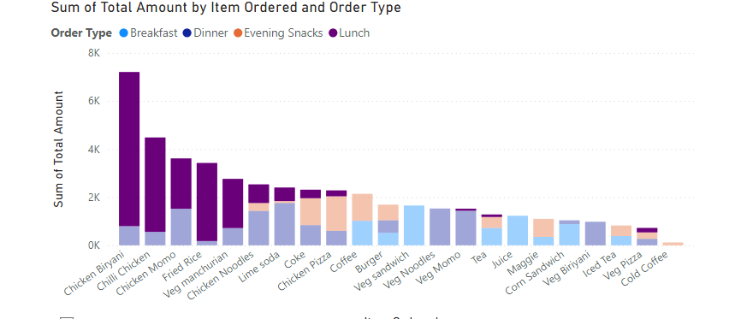
Evening Snacks top selling item is Coke ,
Chicken Pizza, Coffee , Burger, Maggie
Dinner time top selling item is Chicken Biryani ,
Chili Chicken, Chicken Momo, Fried Rice ,
Veg Manchurian

Slide 6
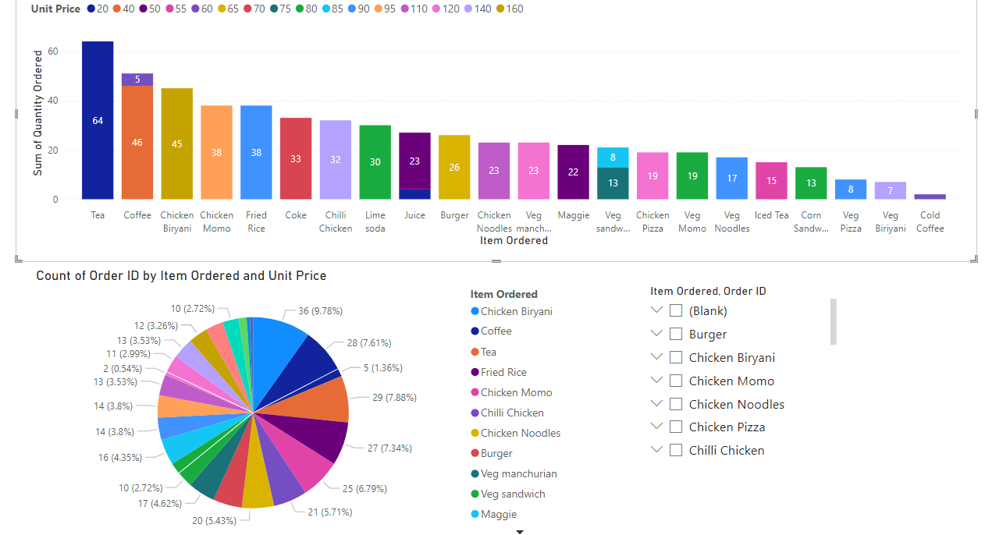

Slide 7
Conclusions
Most sold items: Tea(64 Units) and Coffee(51 Units) are the highest- selling item. During breakfast and evening snacks.
Least sold items:
Cold coffee (2 Units) and Veg Biryani(7 Units) this two item are lowest sales across all meal times
Promoting high demand items like Tea , Coffee ,Chicken Biryani , Fried Rice.
Low demand items are promoting for the combo offer like Cold Coffee + Veg sandwich, Veg biryani + veg Manchurian and Veg Noodles + veg Manchurian

